Slide 1
Starting with Project Requirements
Business rules
Workflows
Tech stack
Architecture
Notes:
Shift to greenfield best practices: requirements, prompts, and verification workflows.

Slide 2
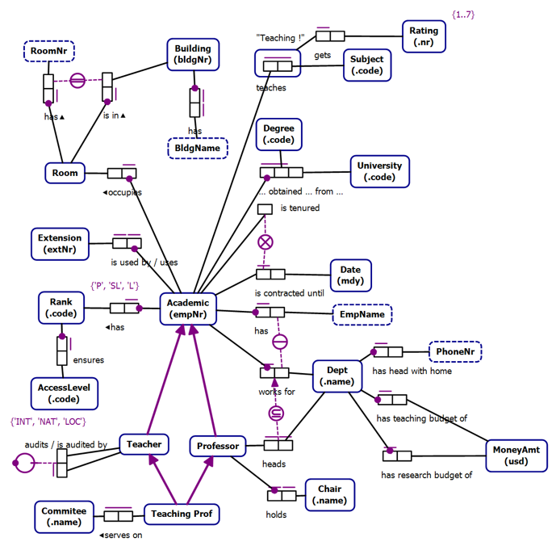
Business Rules as Requirements

Slide 3
Conceptual Models
Technology Agnostic
Transformable into Logical Models
Clarity
Expressive
Formal
Conceptual Models are not a requirement

Slide 4
Object Role Models
A type of conceptual model
Supported by a Visual Studio Extension (NORMA)
Object Role Models are textual and visual
Text can be visualized
Diagrams can be verbalized
Textual representation is in a formal natural language that can be validated by subject matter experts

Slide 5
Zeus.Academia.3b
Based on a publicly available model of a commonly understood domain
https://orm.net/pdf/ORMwhitePaper.pdf
Allows us to quickly move from requirements to implementation
https://github.com/johnmillerATcodemag-com/zeus.academia.3b
Why 3b?
Third Iteration in progress
If something is hard, do it often

Slide 6
Use Cases
Use cases are specific scenarios that guide data capture and processing in the application
Promote a Lecturer to Senior Lecturer
Promote a Senior Lecturer to Associate Professor
Promote an Associate Professor to Professor
Assign a Class to an Academic
Add a new Academic to the faculty capturing all required information and allowing the capture of optional information

Slide 7
Exercise: Generate Business Requirements
Duration: 20 minutes
Objectives:
Use the Product Manager chat mode to create a requirements document for a calculator
Activities:
Activate the Product Manager chat mode
Prompt the AI to create a requirements document
Review the requirements
Add an implementation plan using vertical slices
Review the changes
Add a diagram showing the relationship between Phases, Slices, and User Stories
Success Criteria
The requirements document exists and passes review
Notes:
Author requirement docs, then use Copilot to generate scaffolding and validate alignment.
Prompt: create a requirements document for a simple calculator application

Slide 8
Exercise: Create Project Requirement
Objective: Create project requirement instructions, some project-specific, some generic, using both manual and Copilot-assisted methods.
Manually create a business requirements.md file and add:
Business rules
Workflows
Purpose
Tech stack
Architecture
Use Copilot to generate instruction files using the copilot-instructions.md and the codebase for context.
Bonus:
Review instruction files for errors and omissions.
Ask Copilot to suggest changes based on evolving tech and practices.
Notes:
Author requirement docs, then use Copilot to generate scaffolding and validate alignment.

Slide 9
Exercise: Generate Business Requirements
Duration: 20 minutes
Objectives:
Use the Product Manager chat mode to update the requirements document to implement using vertical slices
Activities:
Activate the Product Manager chat mode
Prompt the AI to add a vertical slices implementation plan
Review the changes
Add a diagram showing the relationship between Phases, Slices, and User Stories
Success Criteria
The implementation plan passes review
Notes:
Prompts:
using #file:business-rules-to-slices.instructions.md update the #file:calculator-app-requirements.md implementation plan to implement using vertical slices
what is the difference between the phases and vertical slices?
update the plan to make this distinction clear
add a diagram that shows the phases -> slices -> use cases
which of the slices can be implemented in parallel and which have a dependancy on another slice

